Slide 1

SQL Project
Ironhack
2023

Slide 2


Slide 3
Tabla | Nulos | Duplicated | Drop | Changes
actor | No | SUSAN DAVIS | last_update | Capitalize first & last name
category | No | No | last_update
film | original language | No | last_update | Upper title & description
inventory | No | No | last_update
language | No | No | last_update
old_HDD | No | No | release_year
rental | No | No | last_update

Slide 4


Slide 5

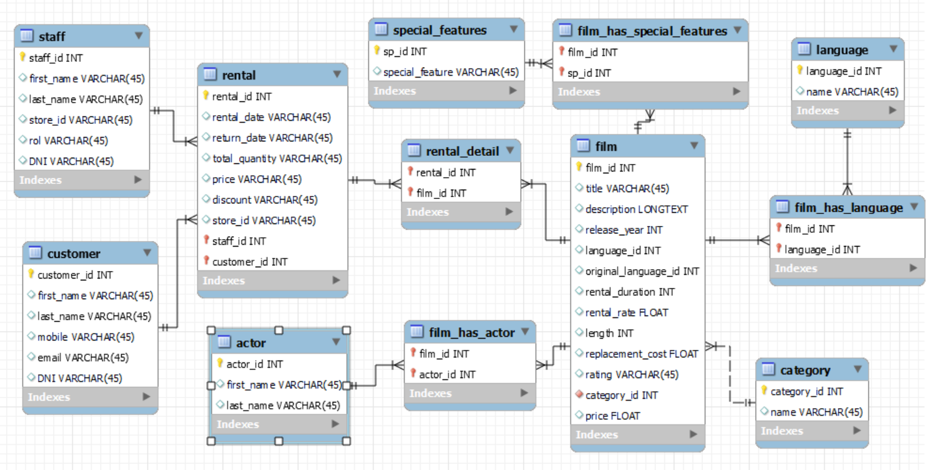
Inventory
Old_HDD

